Slide 1
Welcome to the San Jose Soccer Referee Association!
2020 Annual General Meeting
December 7, 2020

Slide 2
Agenda
Introduction of Board Members
Review of 2020
Club Membership
Club Activities
Referee of the Year Awards
SJSRA Presenter Pool (new)
Financial for 2020
Budget for 2021
Election of Officers

Slide 3
SJSRA Board Members (1 of 2)
Office | 2020 Board Member | Up for Re-election | 2020 Officer or Candidate
President | Tibor Polgar | No | Tibor Polgar
Vice President | Dana Johnston | Yes
Secretary | Carl Jones | Yes
Treasurer | George Tharakan | Yes
Clinician | Joe Dickerson | No | Joe Dickerson
Clinician | Peter Fletcher | Yes
Youth Coordinator | Tibor Polgar | Yes

Slide 4
SJSRA Board Members (2 of 2)
Office | 2020 Board Member | Up for Re-election | 2020 Officer or Candidate
Adult Coordinator | Lee Berg | No | Lee Berg
Webmaster | Kurt Swanson | No | Kurt Swanson
Special Event Cordinator | Bruce Craig | No | Bruce Craig (supporting only)
Special Event Cordinator | Kayvon Pejooh | Yes
Membership Coordinator | Beau James | Yes
Membership Coordinator | Erik Levine | No | Erik Levine

Slide 5
SJSRA Membership Groups
Paid Members
Pay $30/year to support the club
Complementary Members
Award winners from Referee of the Year Awards

Slide 6
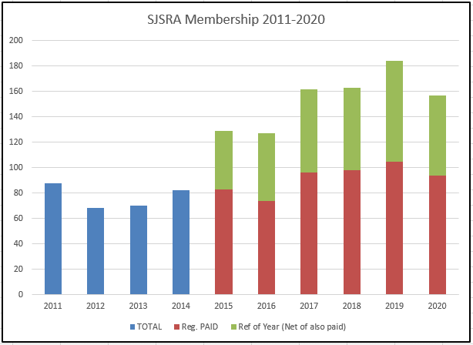
Membership History

Slide 7
Referee of the Year Awards
Each December, SJSRA hosts the Referee of the Year Awards to allow local leagues to recognize their best referees
SJSRA organizes the event and speakers with support from the local leagues
Award recipients receive free membership in SJSRA for the coming year
The 2020 event was canceled because of COVID

Slide 8
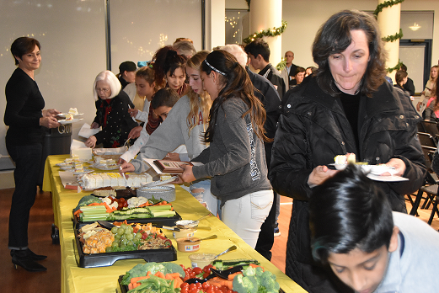
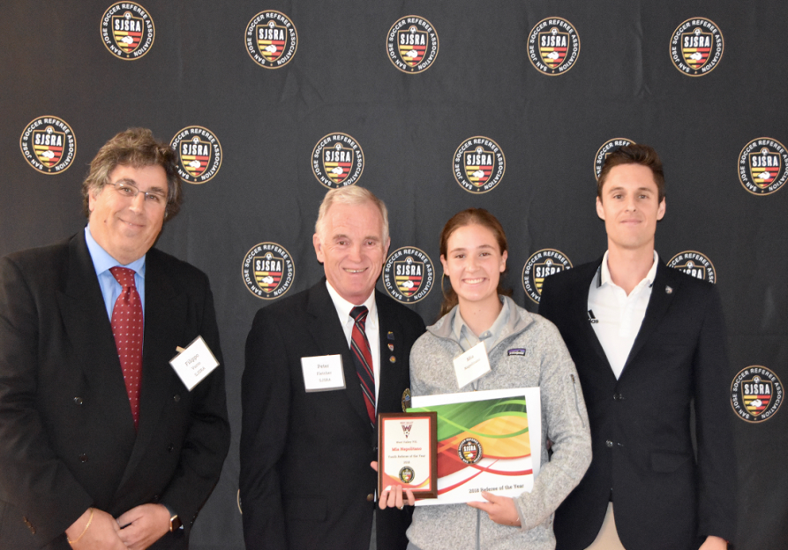
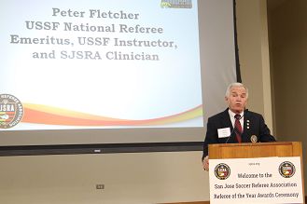
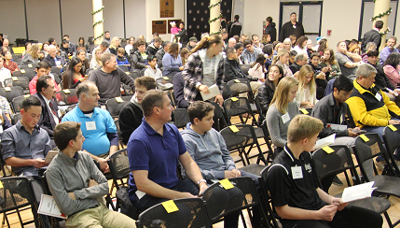
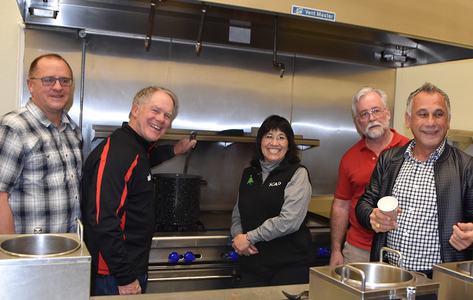
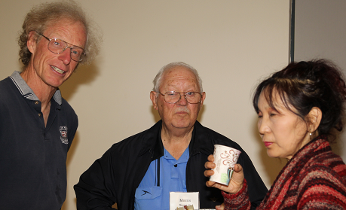
See You in 2021 Referee of the Year Awards

Slide 9
SJSRA Presenter Pool
We would like to expand the pool of presenters available for SJSRA meetings
We are asking ALL current and past Instructors/Assignors/Ref-Coaches to participate
Have (or develop) at least one 20 minute presentation appropriate for SJSRA
Be available to present if needed on short notice

Slide 10
SJSRA 2020 Financials & Proposed 2021 Budget
Switch to Spreadsheet

Slide 11
Election of Officers
Office | 2020 Board Member | Up for Re-election | 2020 Officer or Candidate
Vice President | Dana Johnston | Yes | Dana Johnston
Secretary | Carl Jones | Yes | Carl Jones
Treasurer | George Tharakan | Yes | George Tharakan
Clinician | Peter Fletcher | Yes | Peter Fletcher
Youth Coordinator | Tibor Polgar | Yes | Ron Leedy
Special Event Coordinator | Kayvon Pejooh | Yes | Kayvon Pejooh
Membership Coordinator | Beau James | Yes | Beau James

Slide 12
Q&A

